Slide 1
Search Bias Correction in B2C MMM

Slide 2
Search Bias Correction (SBC) in B2C MMM
Research Question and Causal Diagram
Research Question and Causal Diagram
Directed Acyclic Graph(DAG): Other Causal Structure
Data: Outcome, Intervention, and Confounder
Modeling Causality
Model Specification
Application of SBC to MMM
Model Results
Model Results and DAG
SBC Factors
What’s Next

Slide 3
Research Question and Causal Diagram
Research Question
How to estimate the causal effect of paid search on sales in the context of Media Mix Modeling(MMM)
Causal Diagram for Paid Search
The back-door criterion:
Z, Confounder: Google Search Index
X, Intervention: Paid Search Spend
Y, Outcome: True Gross Adds
The causal effect of X on Y can be correctly estimated
by including Z if the DAG be true.
Otherwise, the impact of X will be overrated.
Z
X
Y

Slide 4
DAG: Possible Causal Relationships
 | Fork | Pipe | Collider
DAG
Role of Z | Z Is a common cause of X & Y. | Z Is a mediator between X & Y. | Z Is a common outcome of X & Y.
Relationship (Conditional Dependence / Independence) | X & Y become dependent without Z. X & Y become independent with Z. | X & Y become dependent without Z. X & Y become independent with Z. | X & Y become independent without Z. X & Y become dependent with Z.
Z
Z
Z
X
Y
X
Y
X
Y
We will investigate what are the true unknown relationships among X, Y, and Z.

Slide 5
Data: Outcome, Intervention, and Confounder
Type | Description
Outcome | True Gross Adds (TGA) Sales
Intervention | Paid Search - Brand
Confounder | Google Search Index: Altice, Competitor, and Non-Brand Other media channels: Audio, Display, DM, PaidSearch_UnBrand, Print, Radio, Social, TV, and Video
Study Period | 2017-12-31 ~ 2020-03-22 by week. 117 weeks
Analysis Unit | DMAs 30 DMAs x 117 weeks = 3,510 observations

Slide 6
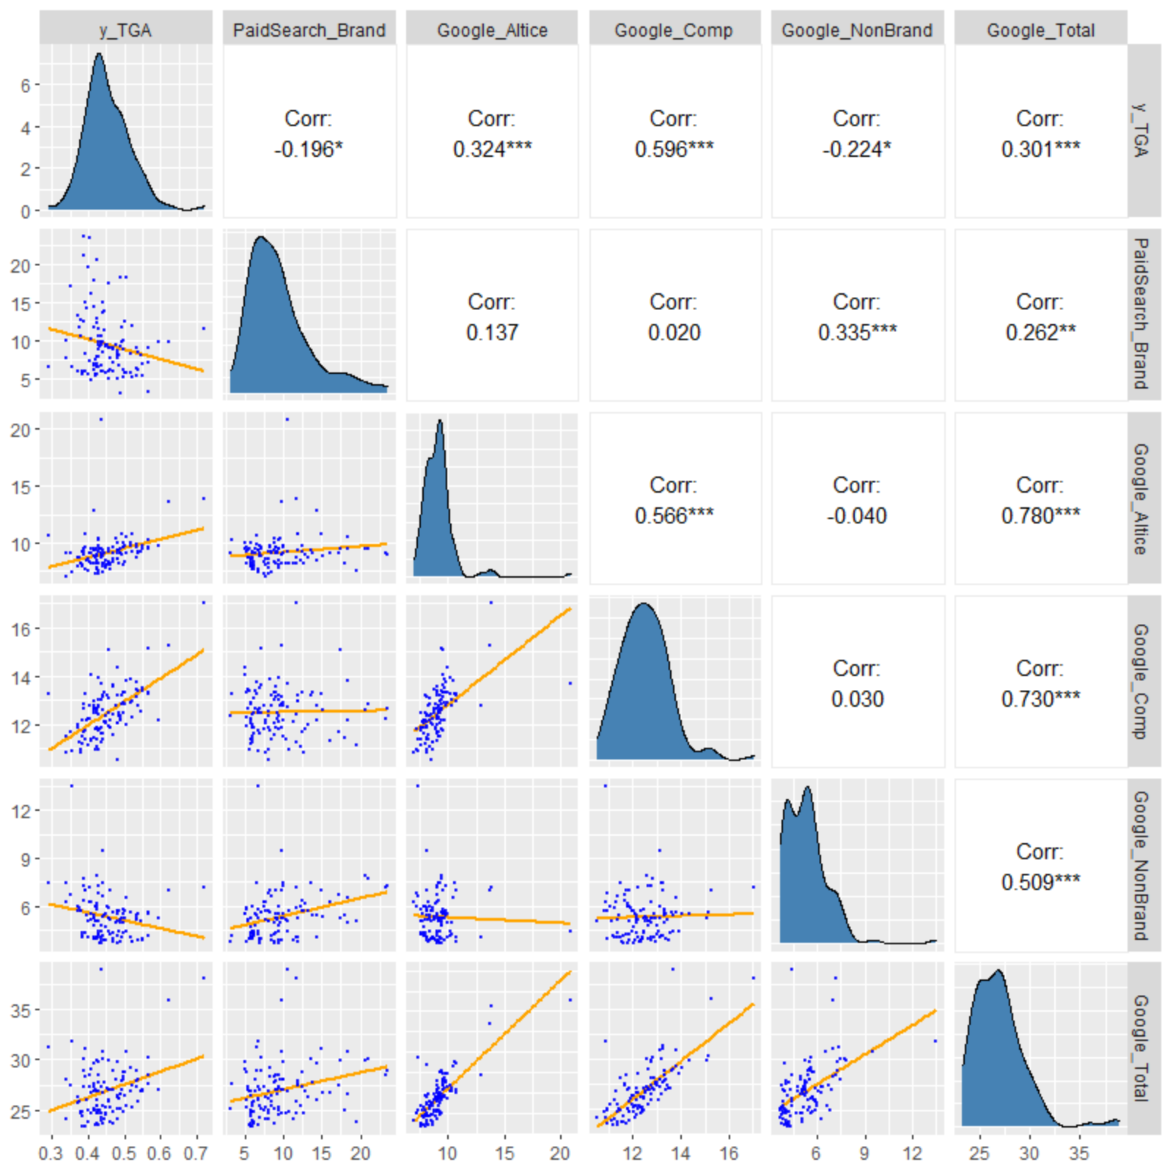
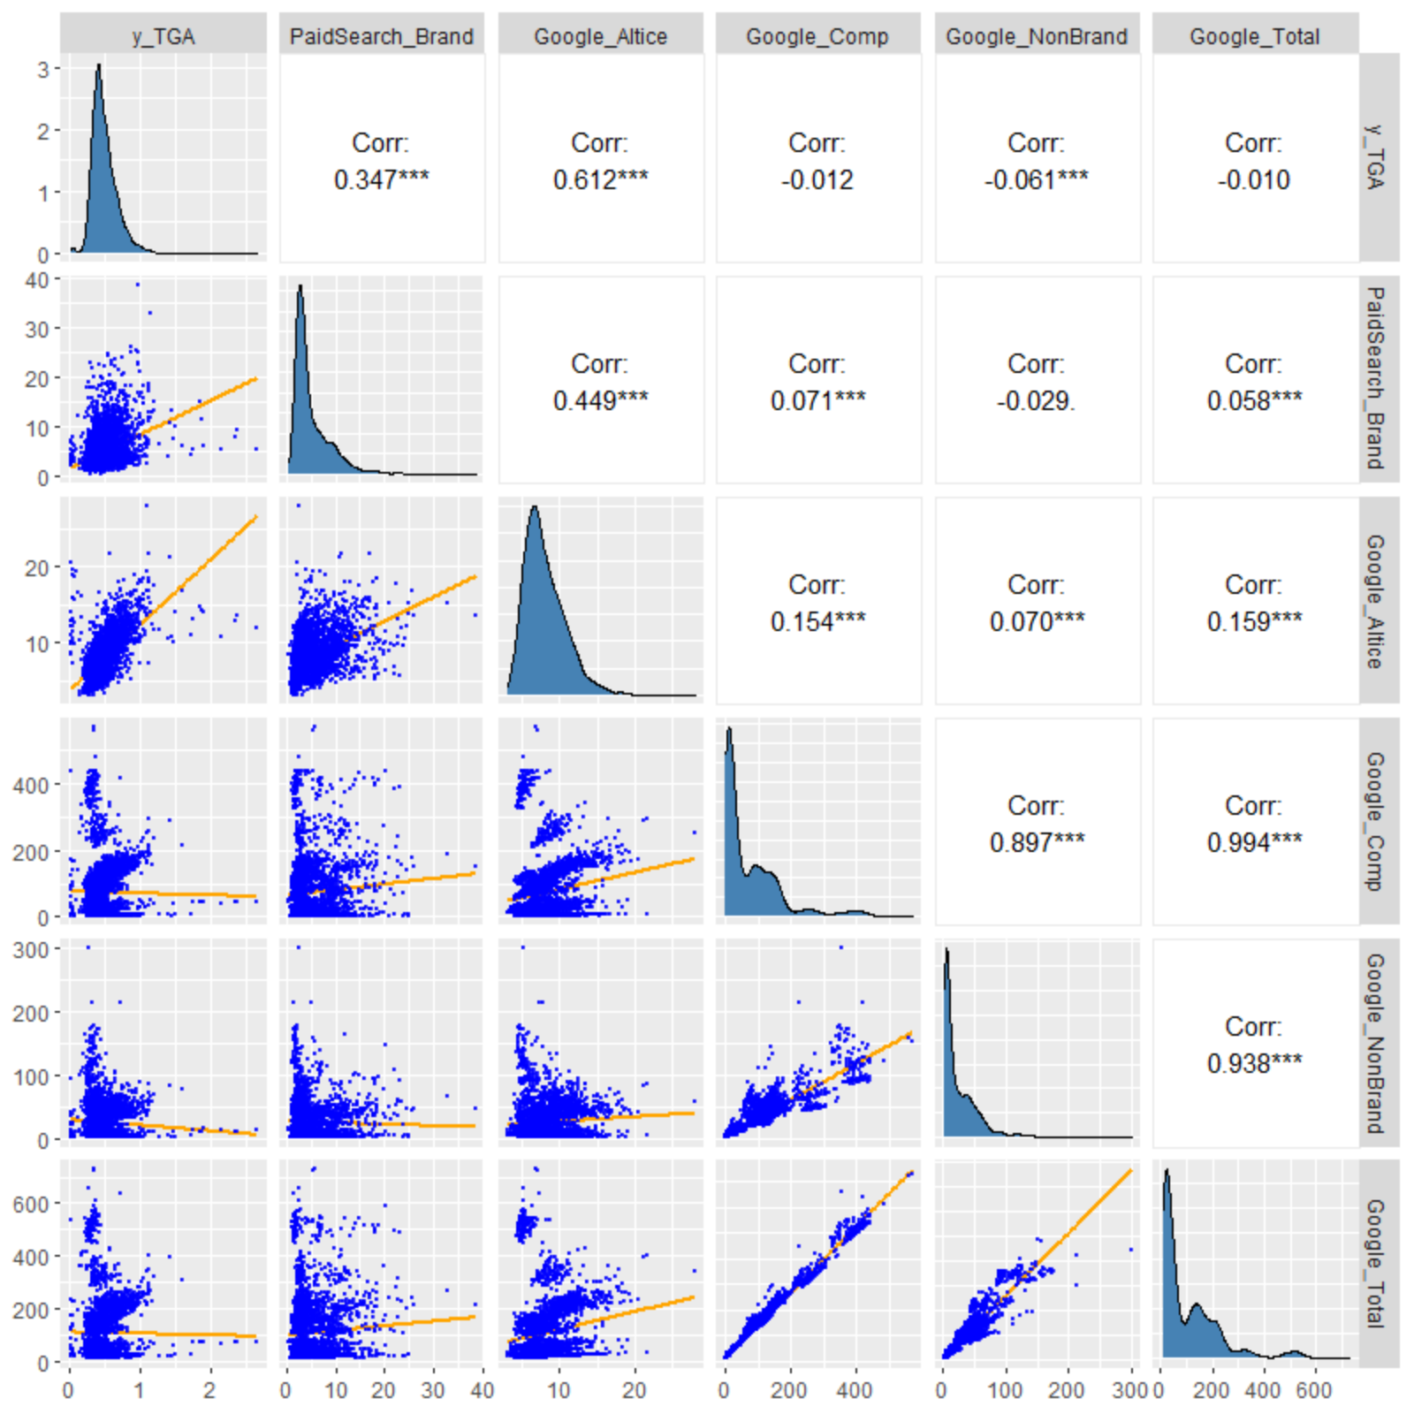
Pair Plots: Outcome, Intervention, and Confounder
OPT
SDL

Slide 7
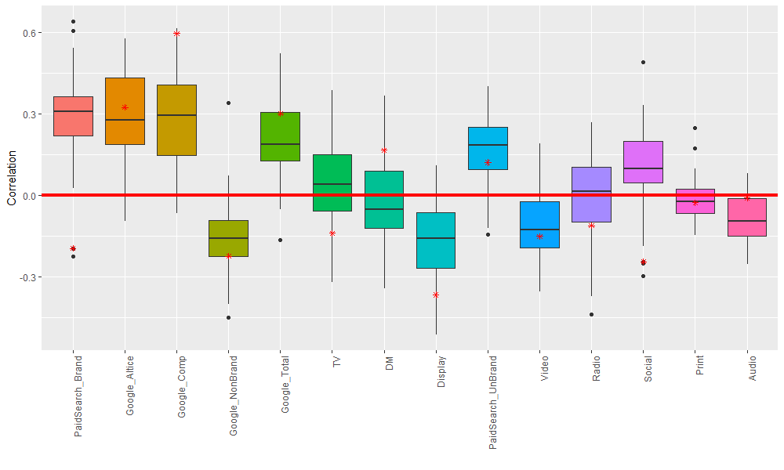

Box Plots: Heterogeneous Empirical Association with TGA by DMA
$∗$ OPT Correlation

Slide 8
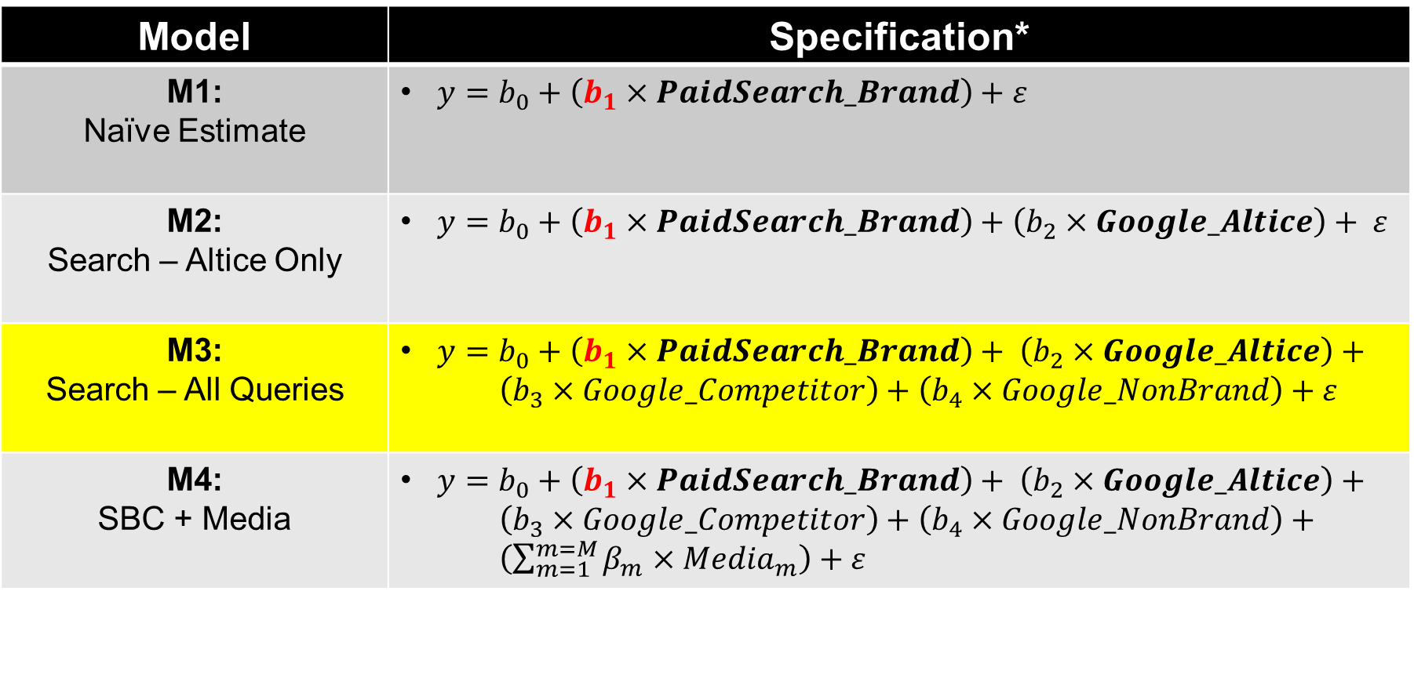
Modeling: Estimating Causal Impact of Paid Search
Model | Specification*
M1: Naïve Estimate | $y=b_{0}+\left(b_{1}×PaidSearch_Brand\right)+ε$
M2: Search – Altice Only | $y=b_{0}+\left(b_{1}×PaidSearch_Brand\right)+\left(b_{2}×Google_Altice\right)+ ε$
M3: Search – All Queries | $y=b_{0}+\left(b_{1}×PaidSearch_Brand\right)+ \left(b_{2}×Google_Altice\right)+$ $\left(b_{3}×Google_Competitor\right)+\left(b_{4}×Google_NonBrand\right)+ε$
M4: SBC + Media | $y=b_{0}+\left(b_{1}×PaidSearch_Brand\right)+ \left(b_{2}×Google_Altice\right)+$ $\left(b_{3}×Google_Competitor\right)+\left(b_{4}×Google_NonBrand\right)+$ $\left(\sum_{m=1}^{m=M}{β_{m}×{Media}_{m}}\right)+ε$
* y = True Gross Adds (TGA)
Google_Total = Google_Altice + Google_Competitor + Google_NonBrand
Media = {TV, DM, Display, PaidSearch_UnBrand, Video, Radio, Social, Print, Audio}

Slide 9
Modeling: Applying SBC to MMM
Criteria | SBC | Altice MMM
Model Specification | Mixed linear regression: random coefficient vs random intercept | Mixed regression with nonlinearly transformed media variables
Estimation | Penalized maximum likelihood estimation Can use Bayesian estimation. | Bayesian estimation in STAN Can’t use frequentist estimation due to model complexities.
Media Variables | Paid Search Multiple channels | Multiple channels
Control Variables | No | Yes
Carryover Effect | No | Yes
Shape Effect | No | Yes
Heterogeneity | Yes by DMA | Yes by DMA
Is GAM Necessary? | Not really; correlation is much lower
Paid Search Bias Correction (SBC) | Estimate the unbiased effect of Paid Search first with the SBC applied. Use the estimated effect of Paid Search as the fixed values in the full MMM. Calibrate the effect of other media channels.

Slide 10
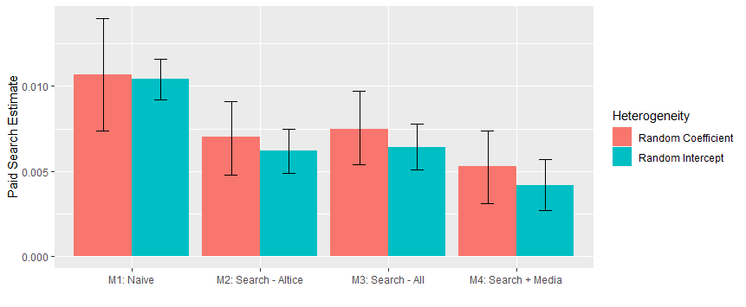
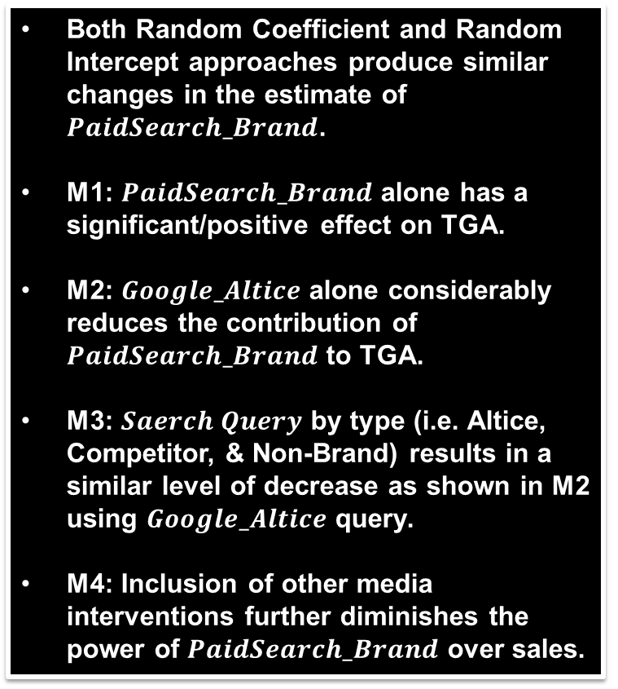
Model Results: Causal Effect of Paid Search by Model
Both Random Coefficient and Random Intercept approaches produce similar changes in the estimate of $PaidSearch_Brand$.
M1: $PaidSearch_Brand$ alone has a significant/positive effect on TGA.
M2: $Google_Altice$ alone considerably reduces the contribution of $PaidSearch_Brand$ to TGA.
M3: $Saerch Query$ by type (i.e. Altice, Competitor, & Non-Brand) results in a similar level of decrease as shown in M2 using $Google_Altice$ query.
M4: Inclusion of other media interventions further diminishes the power of $PaidSearch_Brand$ over sales.

Slide 11
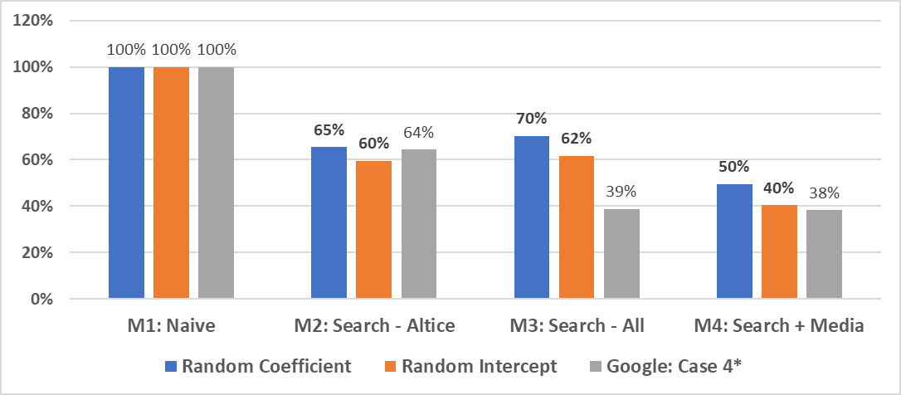
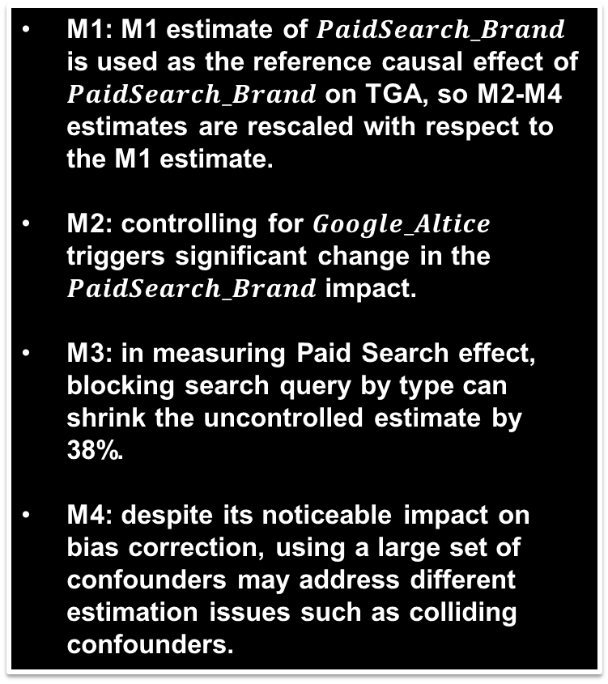
Model Results: SBC Adjustment Factors by Model
M1: M1 estimate of $PaidSearch_Brand$ is used as the reference causal effect of $PaidSearch_Brand$ on TGA, so M2-M4 estimates are rescaled with respect to the M1 estimate.
M2: controlling for $Google_Altice$ triggers significant change in the $PaidSearch_Brand$ impact.
M3: in measuring Paid Search effect, blocking search query by type can shrink the uncontrolled estimate by 38%.
M4: despite its noticeable impact on bias correction, using a large set of confounders may address different estimation issues such as colliding confounders.
* Source: https://arxiv.org/abs/1807.03292
Three years of estimates (i.e. 2013, 2014, & 2015) are aggregated for easy comparison: see Table 7.1 for more information.

Slide 12
What Is Next?
Application of SBC Factors to MMM:
Estimate the impact of Paid Search (PS) from the MMM.
Measure the SBC adjustment factors (AF).
Adjust for the PS impact by applying AF (step 2) to the original PS estimate (step 1).
Re-allocate the change in the PS impact to the rest of the media in proportion to each media’s contribution to TGA.

Slide 13
Un-Branded Paid Search (UBPS)

Slide 14
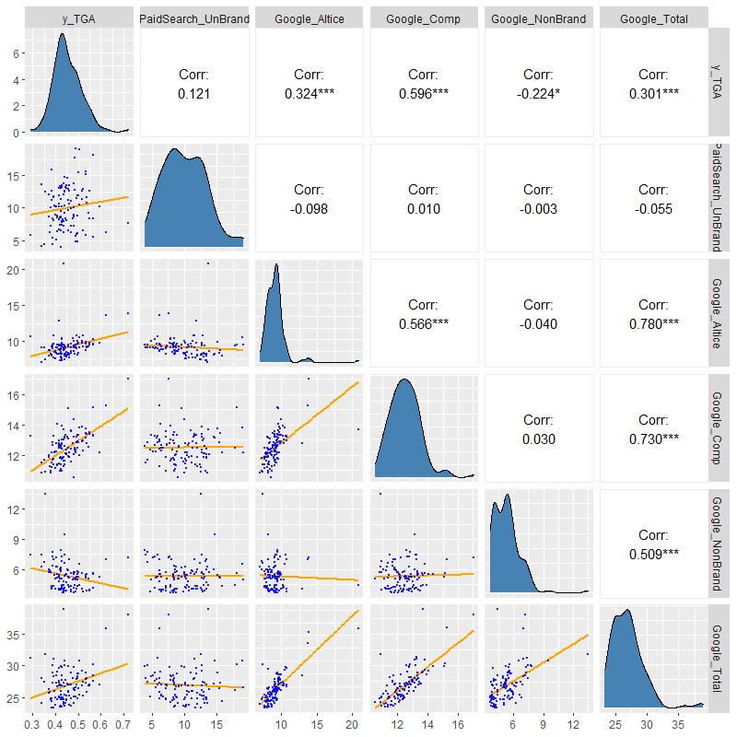
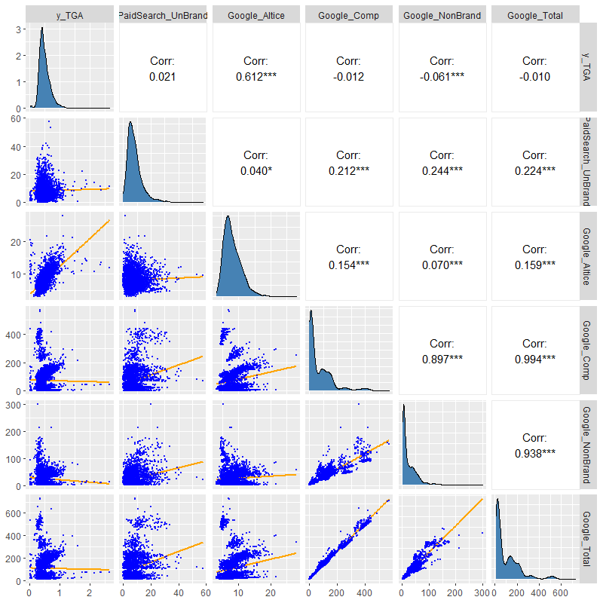
UBPS: Pair Plots
Much Weaker Relationships between Un-Branded Paid Search and Search Queries
OPT
SDL

Slide 15
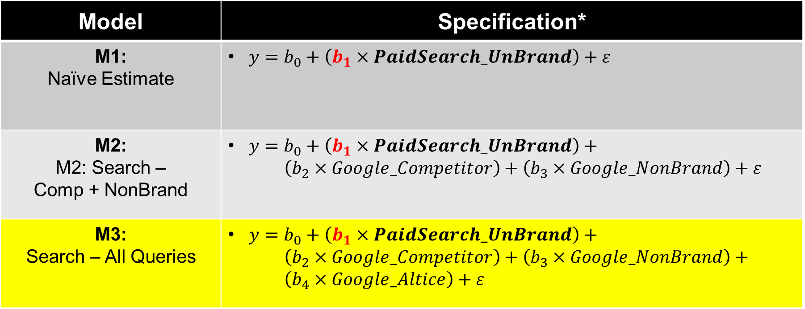
UBPS: Modeling
Model | Specification*
M1: Naïve Estimate | $y=b_{0}+\left(b_{1}×PaidSearch_UnBrand\right)+ε$
M2: M2: Search – Comp + NonBrand | $y=b_{0}+\left(b_{1}×PaidSearch_UnBrand\right)+$ $\left(b_{2}×Google_Competitor\right)+\left(b_{3}×Google_NonBrand\right)+ε$
M3: Search – All Queries | $y=b_{0}+\left(b_{1}×PaidSearch_UnBrand\right)+$ $\left(b_{2}×Google_Competitor\right)+\left(b_{3}×Google_NonBrand\right)+$ $\left(b_{4}×Google_Altice\right)+ε$
* y = True Gross Adds (TGA

Slide 16
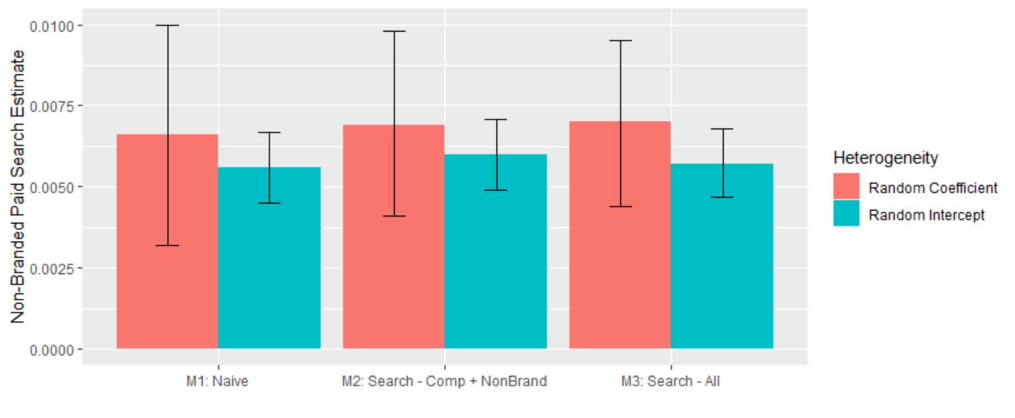
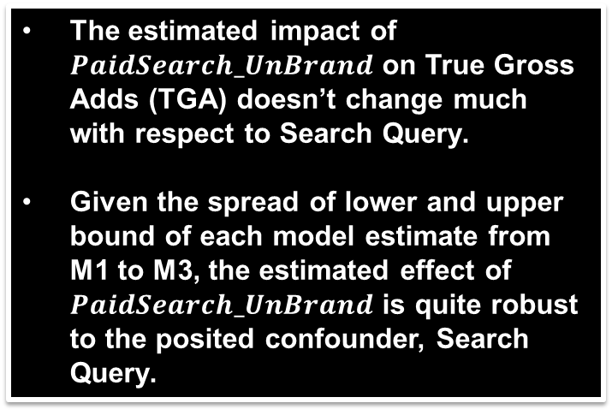
UBPS: Model Results
The estimated impact of $PaidSearch_UnBrand$ on True Gross Adds (TGA) doesn’t change much with respect to Search Query.
Given the spread of lower and upper bound of each model estimate from M1 to M3, the estimated effect of $PaidSearch_UnBrand$ is quite robust to the posited confounder, Search Query.

